Slide 1
JIT2321-DPCO
Unit -2
Combinational Logic

Slide 2
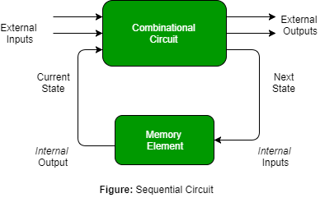
Logic Circuit
Logical Circuits for digital systems may be:
    Combinational
    Sequential

Slide 3
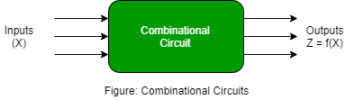
What is Combinational Circuit?
A Combinational Circuit consists of logic gates whose outputs at any time are determined from only the present combination of inputs.
A combinational circuit performs an operation that can be specified logically by a set of Boolean functions

Slide 4
Contd…
A combinational circuit consists of an interconnection of logic gates.
Combinational logic gates react to the values of the signals at their inputs and produce the value of the output signal, transforming binary information from the given input data to a required output data.

Slide 5
How to design a Combinational Circuit
Four steps:
Determine the input and output and assign a constant.
Draw a truth table for inputs and outputs.
Use Boolean Algebra to solve the equation.
Draw the logic circuit using the derived equation.

Slide 6
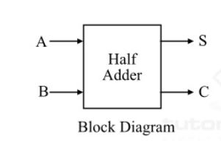
Half Adder
Combinational Circuit
Adder - Circuit which adds
Half Adder- Adds only 2 bits(0,1) [eg. A+B]
0- OFF 1-ON

Slide 7
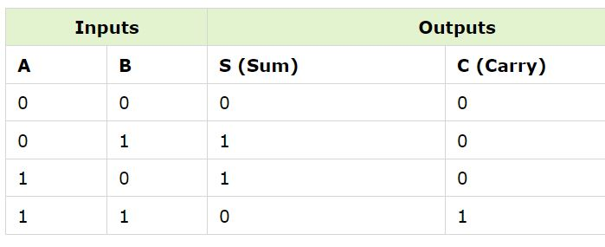

Truth Table & Boolean Expression
Sum (S) = A’B+AB’
Carry(C) = A.B

Slide 8
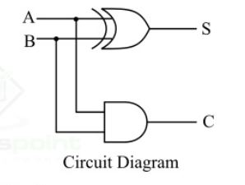
Logic Circuit Diagram

Slide 9
Full Adder
Overcomes the disadvantage of half adder
Usage of 3 bit numbers (0-7)
For more than 3 bits, we can cascade the full adders
Increase in Speed
Carry in s usually the carry from the previous stage.

Slide 10
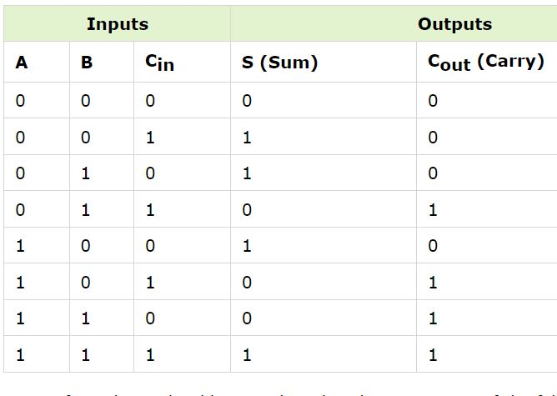
Truth Table

Slide 11
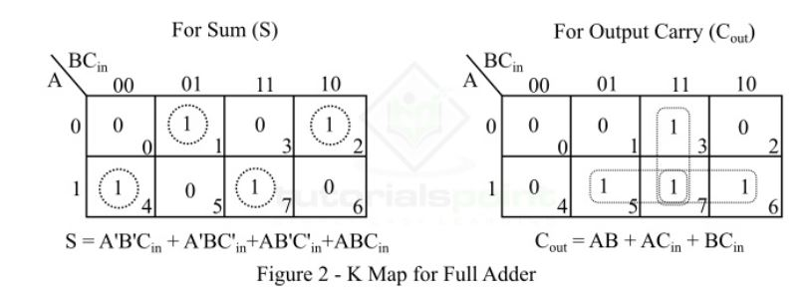
K Map for Full Adder

Slide 12
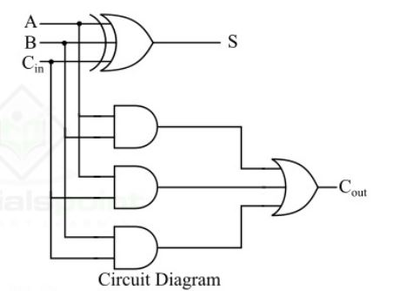
Logic Circuit Diagram

Slide 13
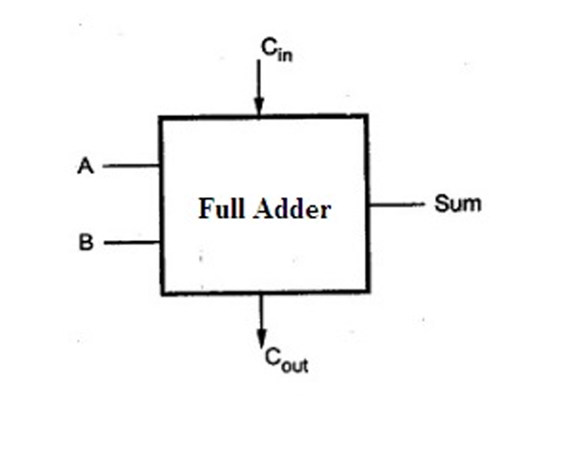
Block diagram

Slide 14
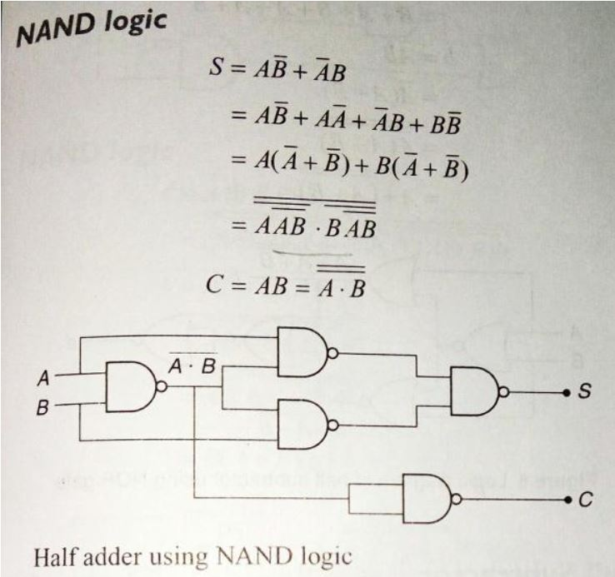
Half Adder using NAND Gates

Slide 15
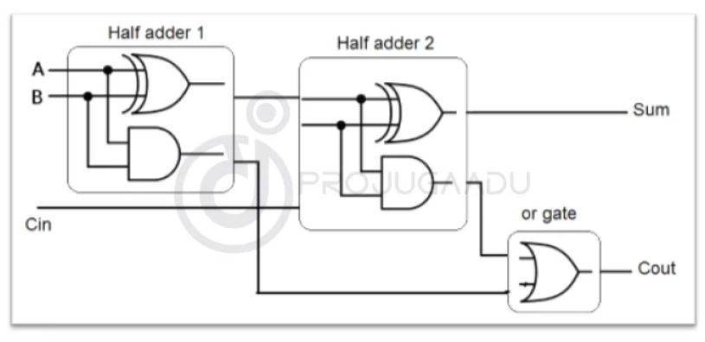
Full Adder using two half adders
Can be implemented with two half adders and one OR gate

Slide 16
Binary Adder
Half Adder(HA) – 2 bits
Full Adder(FA)-3 bits
Binary Adder(BA) – Adds two numbers.
Eg(1011+0011=1110) ➔ 11+3=14
Carry Propagation Problem – Carry Lookahead adder.

Slide 17
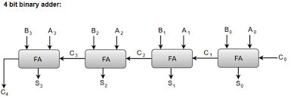
Block Diagram for Binary Adder

Slide 18
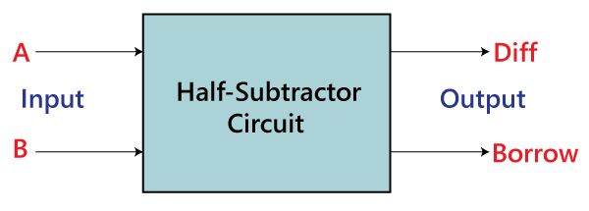
Subtractor – Half subtractor
2 bit input – x, y, D, B
D-Difference B-Borrow
[0-1=> D=1, B=1]

Slide 19
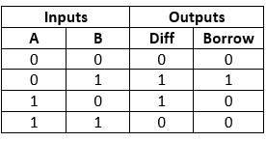
Truth Table-Half Subtractor

Slide 20
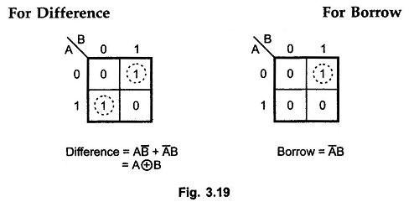
K-Map Half Subtractor

Slide 21
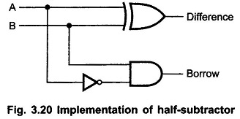
Logic Diagram – Half Subtractor

Slide 22
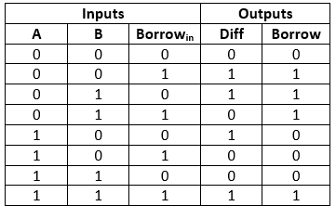
Full Subtractor
Inputs- A,B, Borrowin
Borrowin -Previous Borrow
Truth Table

Slide 23
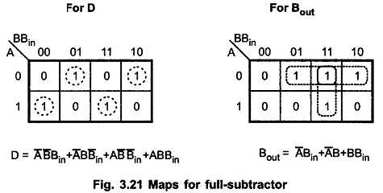
Full Subtractor – K Map

Slide 24
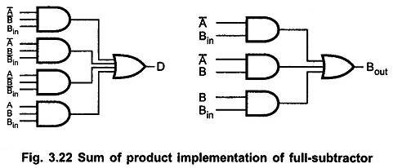
Logic Diagram for Full Subtractor

Slide 25
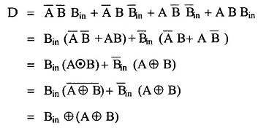
Deriving Equation

Slide 26
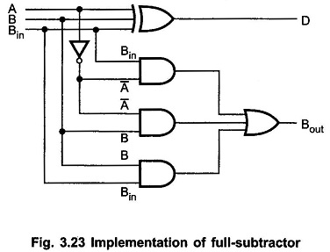
Logic Diagram - 2

Slide 27
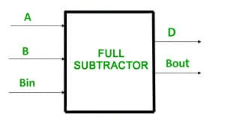
Block Diagram-Full Subtractor

Slide 28
Binary Subtractor
Full Subtractor – Complicate
A-B
Steps:
1. Find 1’s Complement of B
2. Add 1 ➔ 2’s Complement
3. Add the result with A

Slide 29
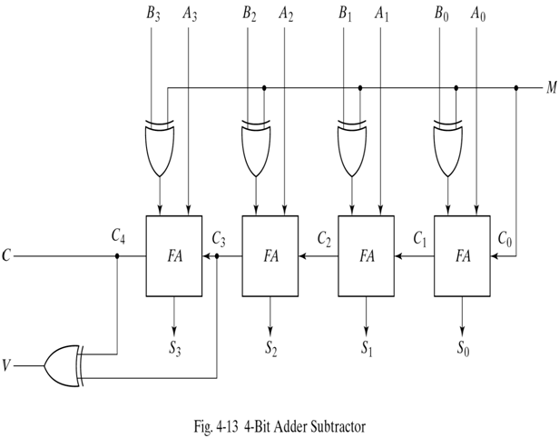
Construct
Two ways – Full Subtractor and full addition

Slide 30
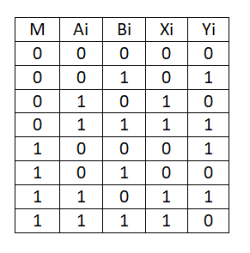
Truth Table or Mapping

Slide 31
BCD Adder/Decimal Adder
Arithmetic addition of adding two decimal digits in BCD.
A varies from (0) 0000 to (9) 1001
B varies from (0) 0000 to (9) 1001
So totally 19=9+9+1(Carry)
Add 6 (0110), if the value is greater than 9 because BCD’s maximum value is 9.

Slide 32
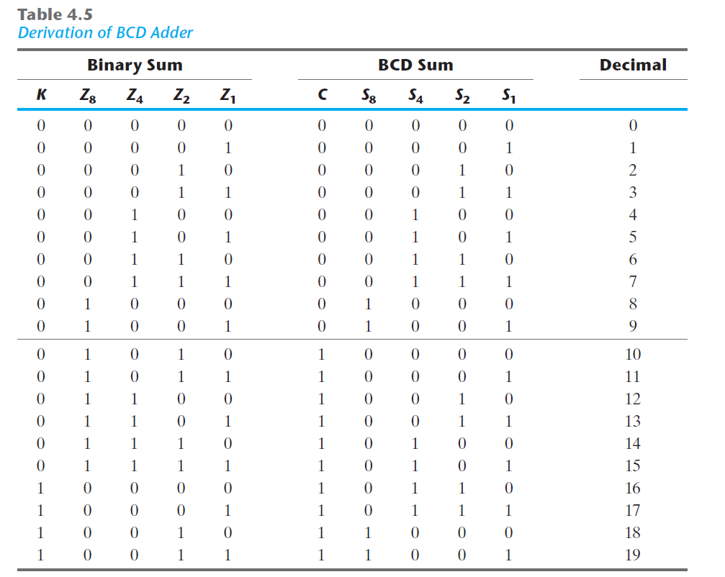

Slide 33


Slide 34
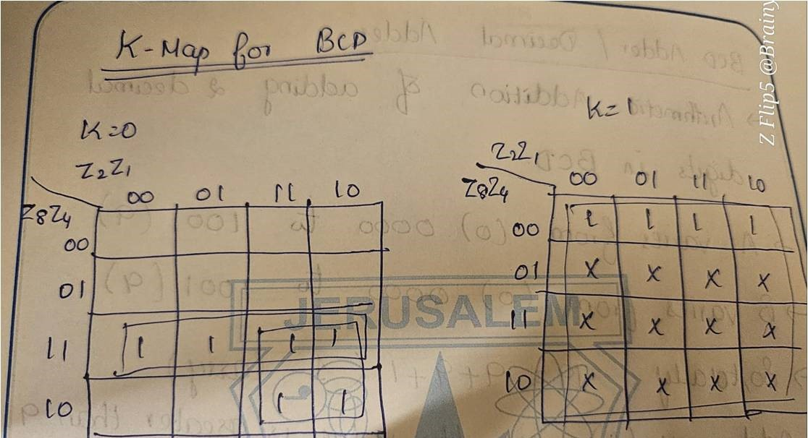

K-Map for BCD Adder

Slide 35
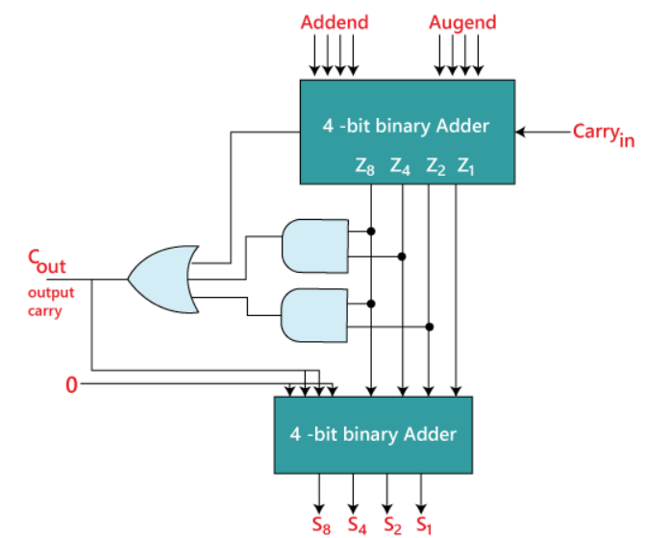
Block Diagram of BCD Adder

Slide 36
Magnitude Comparator
Combinational Circuit that compares two numbers
Outcome is specified by three binary variables A>B, A=B, A<B
Comparing 2 n-bit numbers => Makes 2^{2n} entries in truth table, which is not feasible

Slide 37
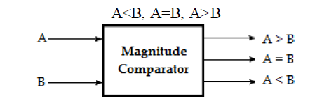
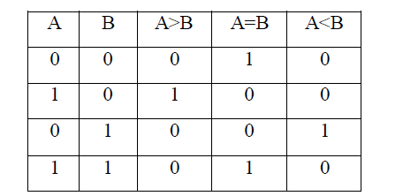
1 – Bit Comparator

Slide 38
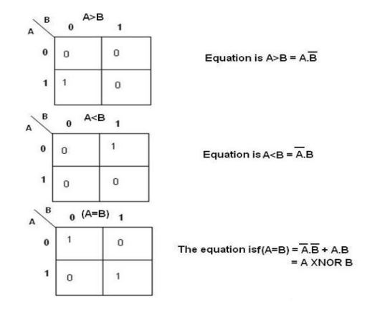
1-bit Comparator

Slide 39
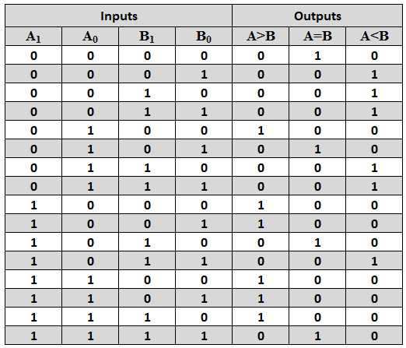
2 – Bit Comparator

Slide 40
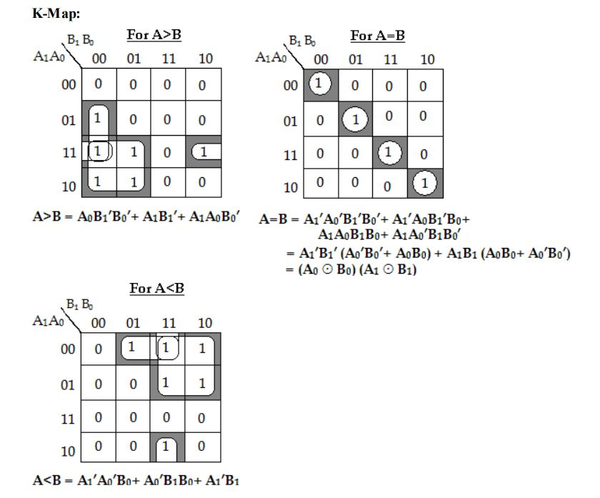
2- Bit Comparator K Map

Slide 41
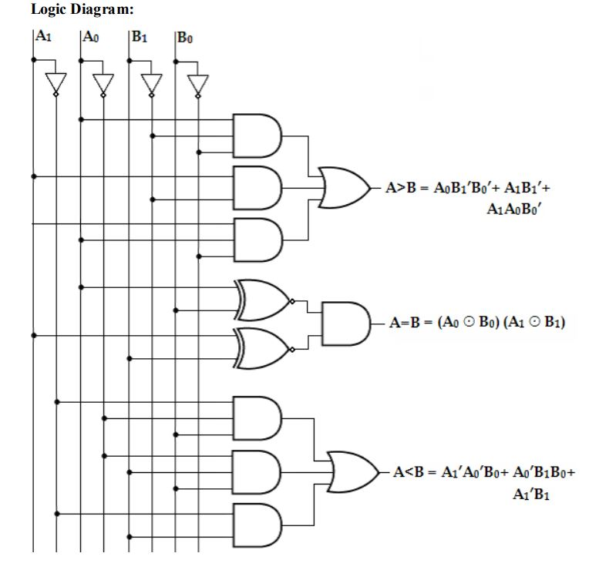
2- Bit Comparator Logic Diagram

Slide 42
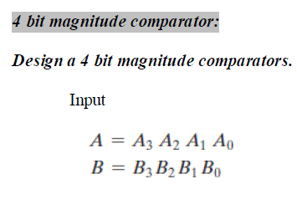
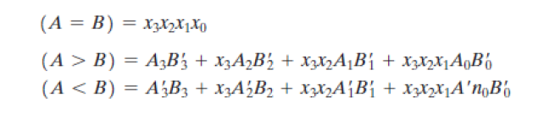

Slide 43
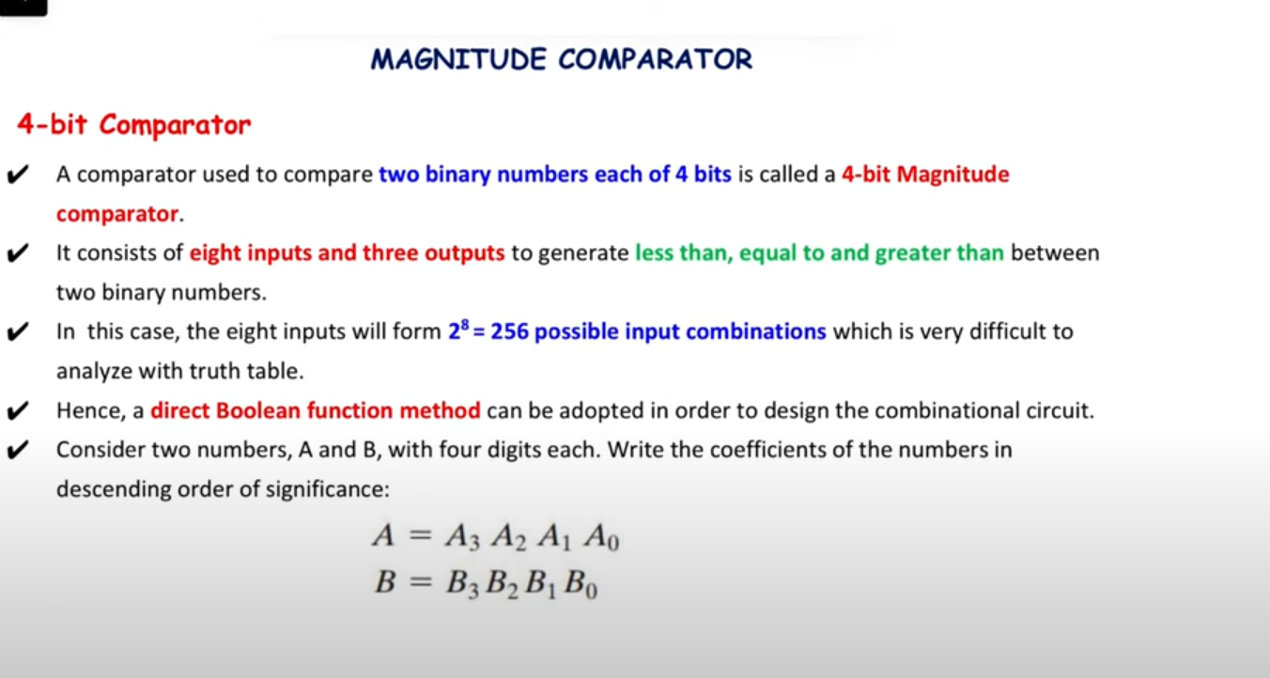

Slide 44
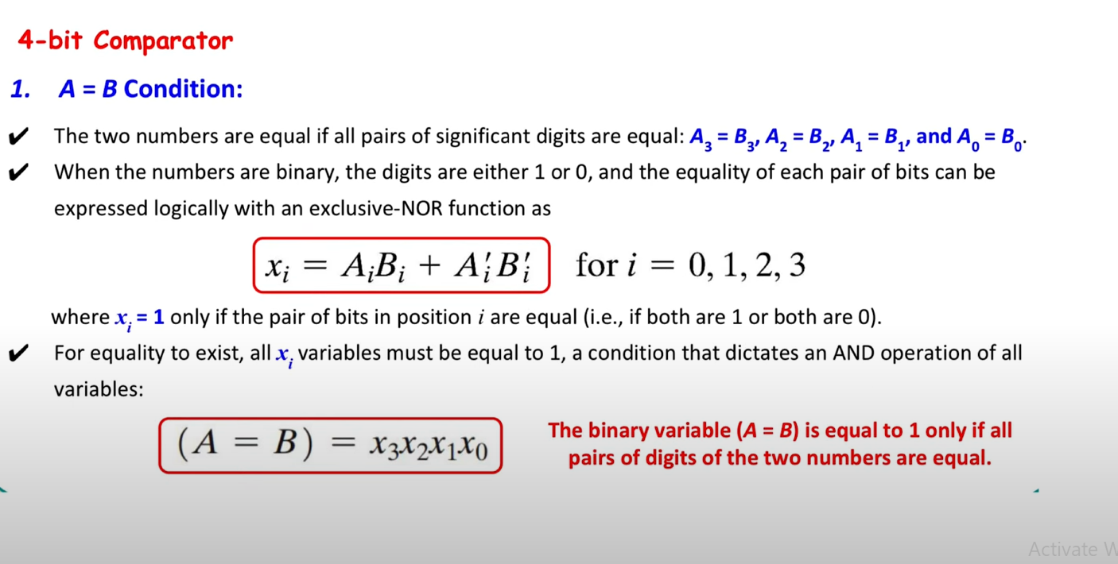

Slide 45
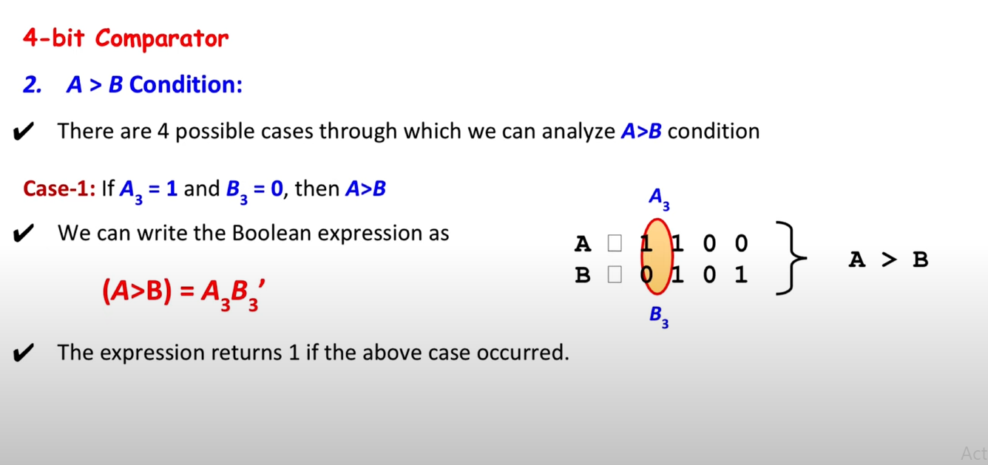

Slide 46
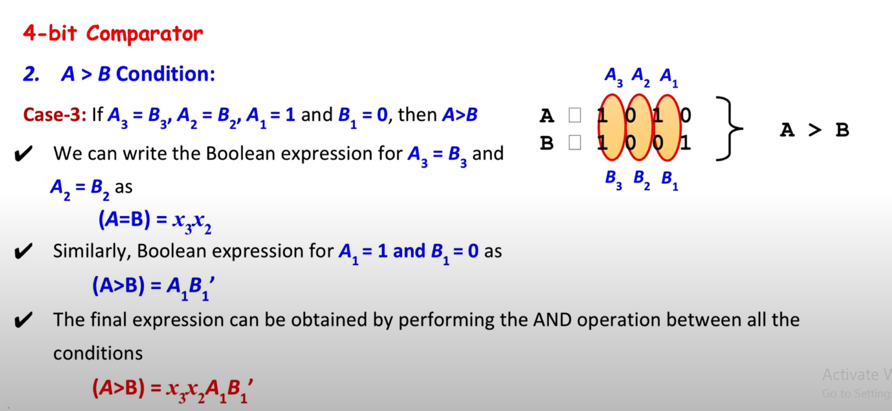

Slide 47
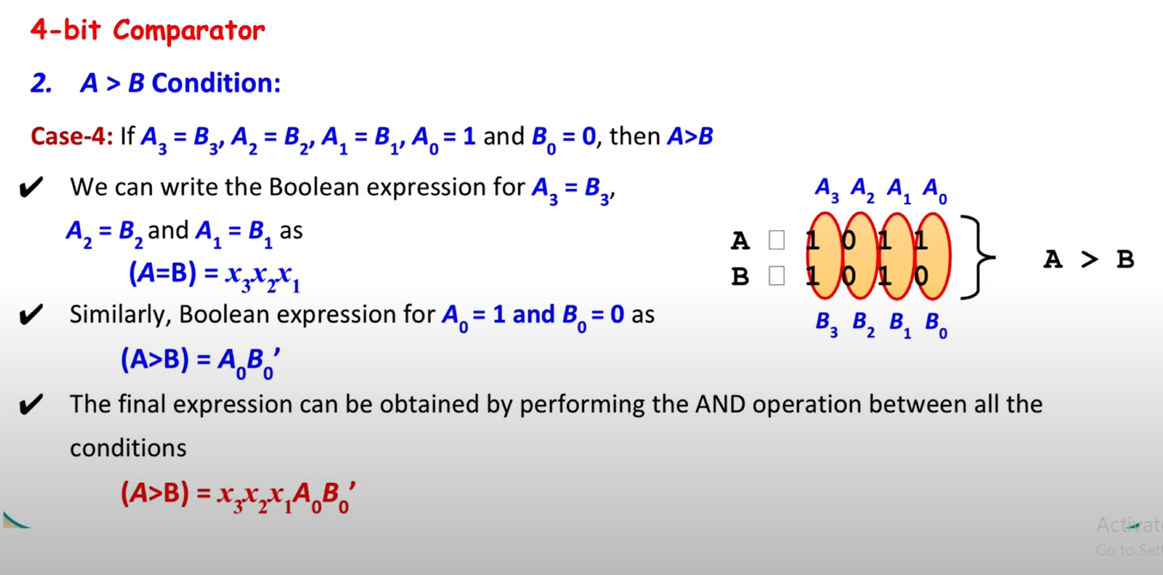

Slide 48
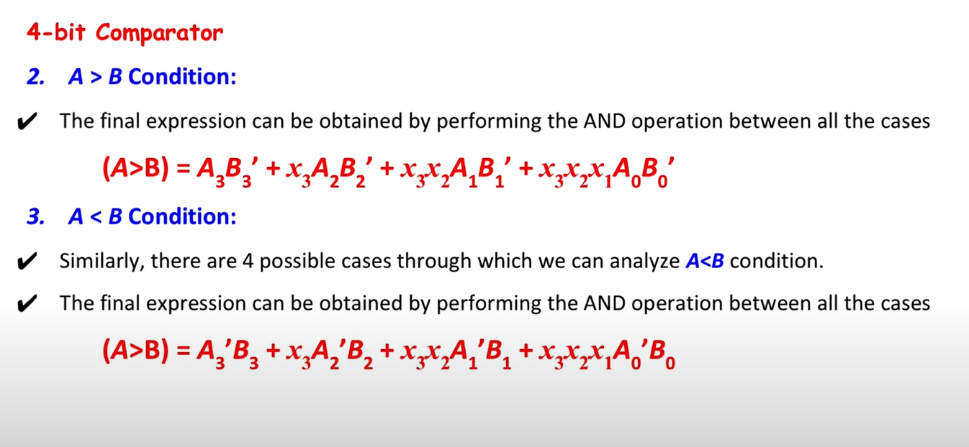

Slide 49
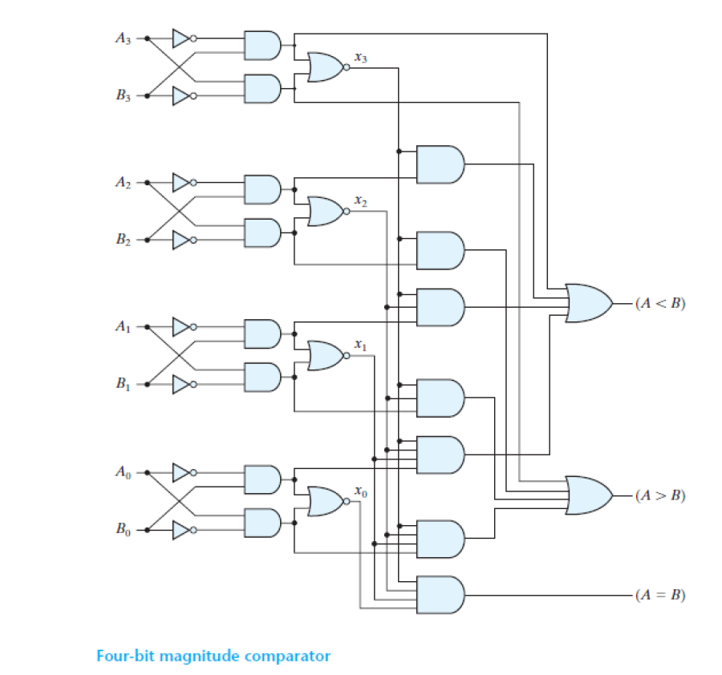

Slide 50
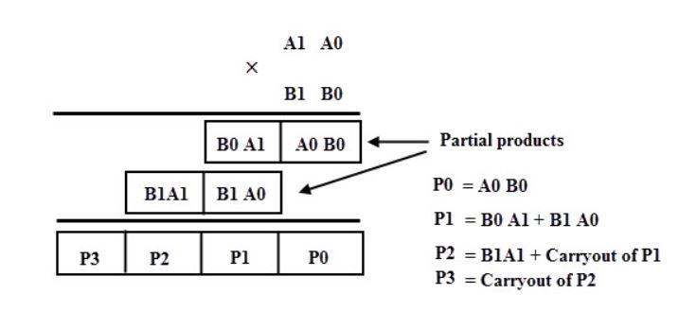
Binary Multiplier
Combinational logic circuit used in digital system to perform multiplication of two numbers.
2-bit binary numbers

Slide 51
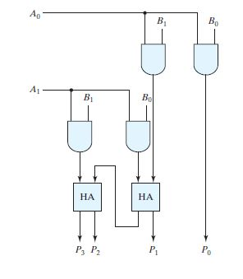

Slide 52
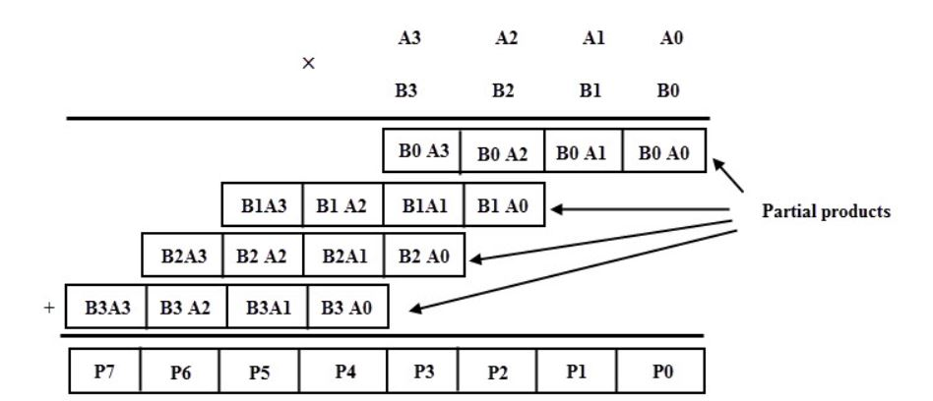
4x4

Slide 53
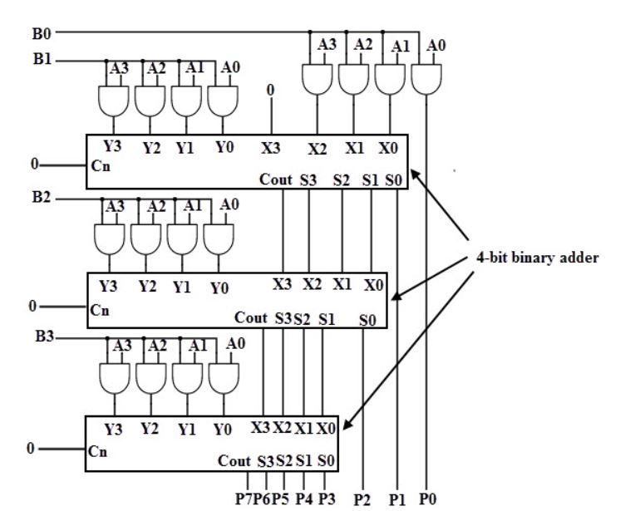
Logic Diagram

Slide 54
Decoder
Decodes
n bit -> 2^{n} different outputs
One output will be active at any point of time
Three inputs(x,y,z)
Eight outputs(D0,D1,D2,D3,D4,D5,D6,D7)

Slide 55
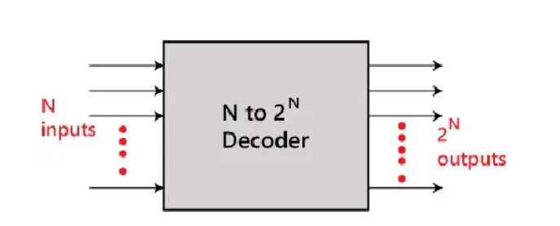
Block Diagram-Decoder

Slide 56
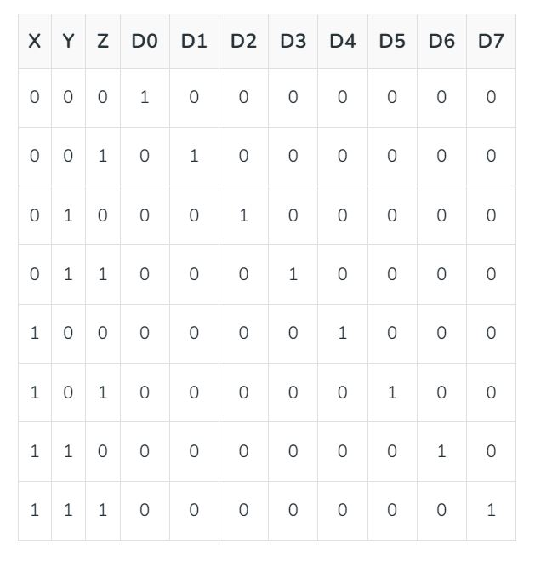

Truth Table - Decoder

Slide 57
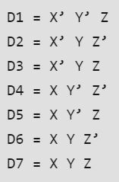
Equations
3 to 8 line decoder
2 to 4 line decoder
4 to 16 line decoder

Slide 58
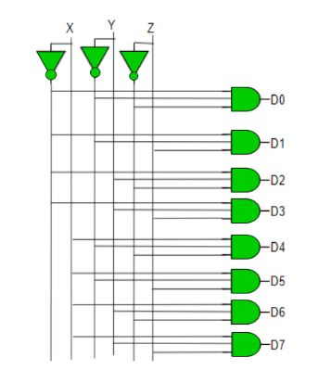
Logic Diagram

Slide 59
Enable Input
Single bit input
0 -> decoder works
1 -> Circuit Disabled
Eg. 2 bit input -> 4 bit output (complemented)
Inputs (E, A, B)
Outputs(D0, D1, D2, D3)

Slide 60

Truth Table
D0=A’B’
D1=A’B
D2=AB’
D3=AB

Slide 61

Logic Diagram

Slide 62

Boolean Function using decoder
Implementation of full adder using decoder

Slide 63


Slide 64

Encoder
Inverse operation of decoder
Input 2^{n} ->Output n

Slide 65

octal-to-binary encoder truth table

Slide 66

  z = D1 + D3 + D5 + D7
  y = D2 + D3 + D6 + D7
  x = D4 + D5 + D6 + D7

Slide 67
Priority encoder
A priority encoder is an encoder circuit that includes the priority function.
The operation of the priority encoder is such that if two or more inputs are equal to 1 at the same time, the input having the highest priority will take precedence.
D0 D1 D2 D3 D0-00,D1-01,D2-10,
1 0 1 0 D3-11

Slide 68
D0 | D1 | D2 | D3 | X(o/p) | Y(o/p) | V(valid)
0 | 0 | 0 | 0 | X | X | 0(invalid) | 0
0 | 0 | 0 | 1 | 1 | 1 | 1 | 1
0 | 0 | 1 | 0 | 1 | 0 | 1 | 2
0 | 0 | 1 | 1 | 1 | 1 | 1 | 3
0 | 1 | 0 | 0 | 0 | 1 | 1 | 4
0 | 1 | 0 | 1 | 1 | 1 | 1 | 5
0 | 1 | 1 | 0 | 1 | 0 | 1 | 6
0 | 1 | 1 | 1 | 1 | 1 | 1 | 7
1 | 0 | 0 | 0 | 0 | 0 | 1 | 8
1 | 0 | 0 | 1 | 1 | 1 | 1 | 9
1 | 0 | 1 | 0 | 1 | 0 | 1 | 10
1 | 0 | 1 | 1 | 1 | 1 | 1 | 11
1 | 1 | 0 | 0 | 0 | 1 | 1 | 12
1 | 1 | 0 | 1 | 1 | 1 | 1 | 13
1 | 1 | 1 | 0 | 1 | 0 | 1 | 14
1 | 1 | 1 | 1 | 1 | 1 | 1 | 15

Slide 69
X={1,2,3,5,6,7,9,10,11,13,14,15}
0 | 1 | 3 | 2
4 | 5 | 7 | 6
12 | 13 | 15 | 14
8 | 9 | 11 | 10
Y={1,3,4,5,7,9,11,12,13,15}
0 | 1 | 3 | 2
4 | 5 | 7 | 6
12 | 13 | 15 | 14
8 | 9 | 11 | 10

Slide 70



Maps for Priority Encoder

Slide 71


Four-input priority encoder

Slide 72
MULTIPLEXERS AND DEMULTIPLEXERS
Multiplexer:
A multiplexer is a combinational circuit that selects binary information from one of many input lines and directs it to a single output line. The selection of a particular input line is controlled by a set of selection lines.
Normally, there are 2n input lines and n selection lines whose bit combinations determine which input is selected.

Slide 73


2 to 1 MUX
A two-to-one-line multiplexer connects one of two 1-bit sources to a common destination, as shown in Fig.
The circuit has two data input lines, one output line, and one selection line S. When S = 0, the upper AND gate is enabled and I₀ has a path to the output.
When S = 1, the lower AND gate is enabled and I₁ has a path to the output.
The multiplexer acts like an electronic switch that selects one of two sources.
y= I₀ s’+ s I₁
wedge-shaped symbol

Slide 74
4 to 1 MUX
A 4 to 1 line multiplexer is shown in figure below, each of 4 input lines I₀ to I₃ is applied to one input of an AND gate.
Selection lines S₀ and S₁ are decoded to select a particular AND gate.
The outputs of the AND gates are applied to a single OR gate that provides the one-line output.
The truth table for the 4:1 mux is given in the table below.

Slide 75
s1 | s0 | I0 | I1 | I2 | I3 | y
0 | 0 | 1 | 0 | 0 | 0 | 1
0 | 1 | 0 | 1 | 0 | 0 | 1
1 | 0 | 0 | 0 | 1 | 0 | 1
1 | 1 | 0 | 0 | 0 | 1 | 1
Y is set to 1 if any one of the row value has 1
How to generate equation for y
Y=S1`S0`I0 + S1`S0 I1 + S1S0`I2 + S1S0I3
At any point of time only one input is selected based on the selection line

Slide 76


Y=s1`s0`I0+s1`s0I1+s1s0`I2+s1s0I3

Slide 77

Boolean Function Implementation with Multiplexers
Implement the Boolean expression using MUX
Three selection line :s0,s1,s2(C,B,A)

Slide 78
 |  | A(s2) | B(s1) | C(s0) | D | F
0 | 0 | 0 | 0 | 0 | 0 | 0 | F=D
1 |  | 0 | 0 | 0 | 1 | 1
2 | 1 | 0 | 0 | 1 | 0 | 0 | F=D
3 |  | 0 | 0 | 1 | 1 | 1
4 | 2 | 0 | 1 | 0 | 0 | 1 | F=D`
5 |  | 0 | 1 | 0 | 1 | 0
6 | 3 | 0 | 1 | 1 | 0 | 0 | F=0
7 |  | 0 | 1 | 1 | 1 | 0
8 | 4 | 1 | 0 | 0 | 0 | 0 | F=0
9 |  | 1 | 0 | 0 | 1 | 0
10 | 5 | 1 | 0 | 1 | 0 | 0 | F=D
11 |  | 1 | 0 | 1 | 1 | 1
12 | 6 | 1 | 1 | 0 | 0 | 1 | F=1
13 |  | 1 | 1 | 0 | 1 | 1
14 | 7 | 1 | 1 | 1 | 0 | 1 | F=1
15 |  | 1 | 1 | 1 | 1 | 1

Slide 79


Slide 80

Implement the Boolean function using Multiplexer
F (x, y, z) = (1, 2, 6, 7)
 |  | X | y | z | F
0 | 0 | 0 | 0 | 0 | 0 | F=Z
1 |  | 0 | 0 | 1 | 1
2 | 1 | 0 | 1 | 0 | 1 | F=Z’
3 |  | 0 | 1 | 1 | 0
4 | 2 | 1 | 0 | 0 | 0 | F=0
5 |  | 1 | 0 | 1 | 0
6 | 3 | 1 | 1 | 0 | 1 | F=1
7 |  | 1 | 1 | 1 | 1

Slide 81
DEMULTIPLEXER(DEMUX)
Communication(one to many)
The de-multiplexer performs the inverse function of a multiplexer, that is it receives information on one line and transmits its onto one of 2^{n} possible output lines.
The selection is by n input select lines. Example: 1-to-4 De-multiplexer

Slide 82

Example: 1-to-4 De-multiplexer

Slide 83





Output Y0 Equation
Output Y2 Equation
Output Y1 Equation
Output Y3 Equation

Slide 84

Logic Diagram

Slide 85

Implement full adder using De-multiplexer.

Slide 86



Slide 87

Example

